Slide 1
Analyzing Pizza Sales Trends and Customer Preferences
Project Overview
This project aims to analyze pizza sales data to uncover trends, customer preferences, and business insights using SQL. The analysis will help optimize marketing strategies, inventory management, and menu offerings.

Slide 2
Objectives
Identify Top-Selling Pizzas:
Determine which pizzas are the most popular by sales volume.
Analyze sales by size and type.
Sales Trends Analysis:
Examine sales trends over time (daily, weekly, monthly).
Identify peak sales periods and seasonal variations.

Slide 3
Objectives
Customer Purchase Patterns:
Analyze repeat purchases and customer loyalty.
Identify customer segments based on purchase history.
Inventory and Ingredient Usage:
Calculate ingredient usage based on pizza sales.
Provide recommendations for inventory management.
Revenue Analysis:
Analyze total revenue and average order value.
Identify any high-performing or underperforming menu items.

Slide 4
Data Sources
Sales Transactions: Order ID, date, time, pizza type, size,
quantity, and price.
Pizza Details: Pizza types, ingredients, and sizes.

Slide 5
Expected Outcomes
A comprehensive report detailing top-selling pizzas and
sales trends
Insights into customer preferences and purchasing
behavior to inform marketing strategies
Recommendations for inventory management based on
ingredient usage analysis.

Slide 6
Questions
Basic level:
Retrieve the total number of orders placed.
Calculate the total revenue generated from pizza sales.
Identify the highest-priced pizza.
Identify the most common pizza size ordered.
List the top 5 most ordered pizza types along with their quantities.
.

Slide 7
Questions
Intermediate level:
Join the necessary tables to find the total quantity of each pizza category ordered.
Determine the distribution of orders by hour of the day.
Join relevant tables to find the category-wise distribution of pizzas.
Group the orders by date and calculate the average number of pizzas ordered per day.
Determine the top 3 most ordered pizza types based on revenue.

Slide 8
Questions
Advanced level:
Calculate the percentage contribution of each pizza type to total revenue.
Analyze the cumulative revenue generated over time.
Determine the top 3 most ordered pizza types based on revenue for each pizza category.

Slide 9
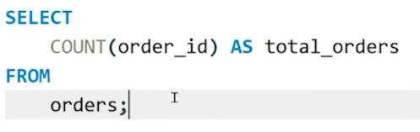
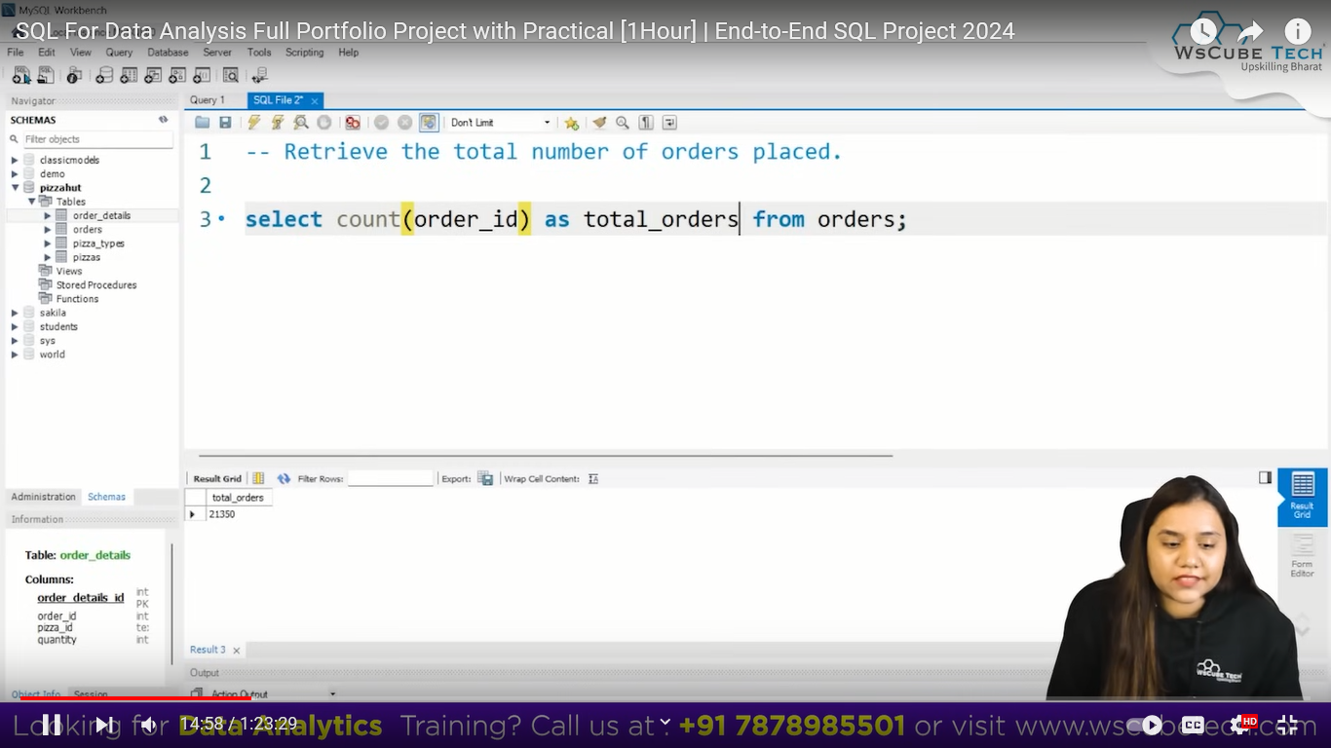
Retrieve the total number of orders placed.

Slide 10
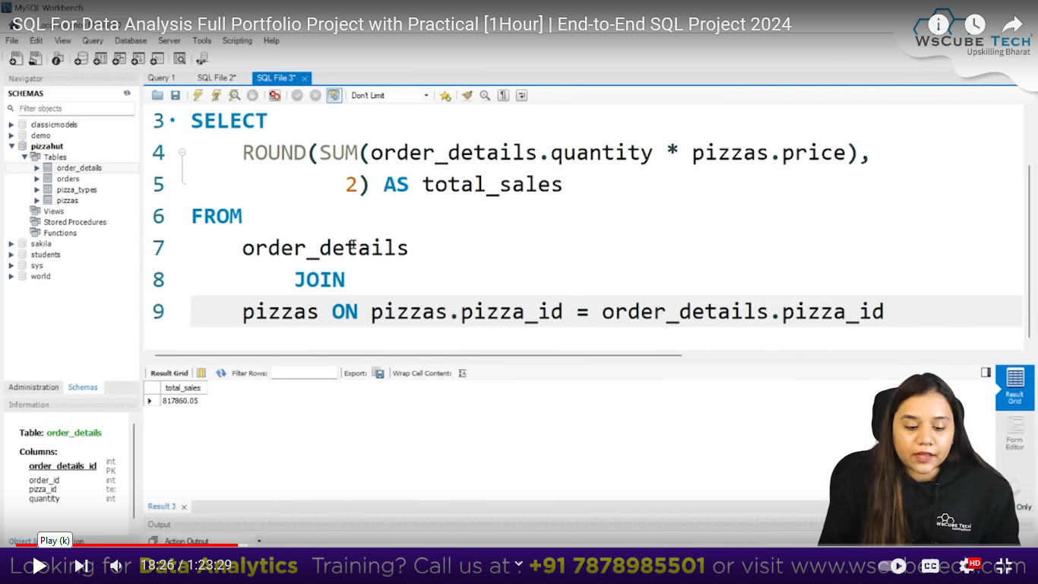
Calculate the total revenue generated from pizza sales.

Slide 11
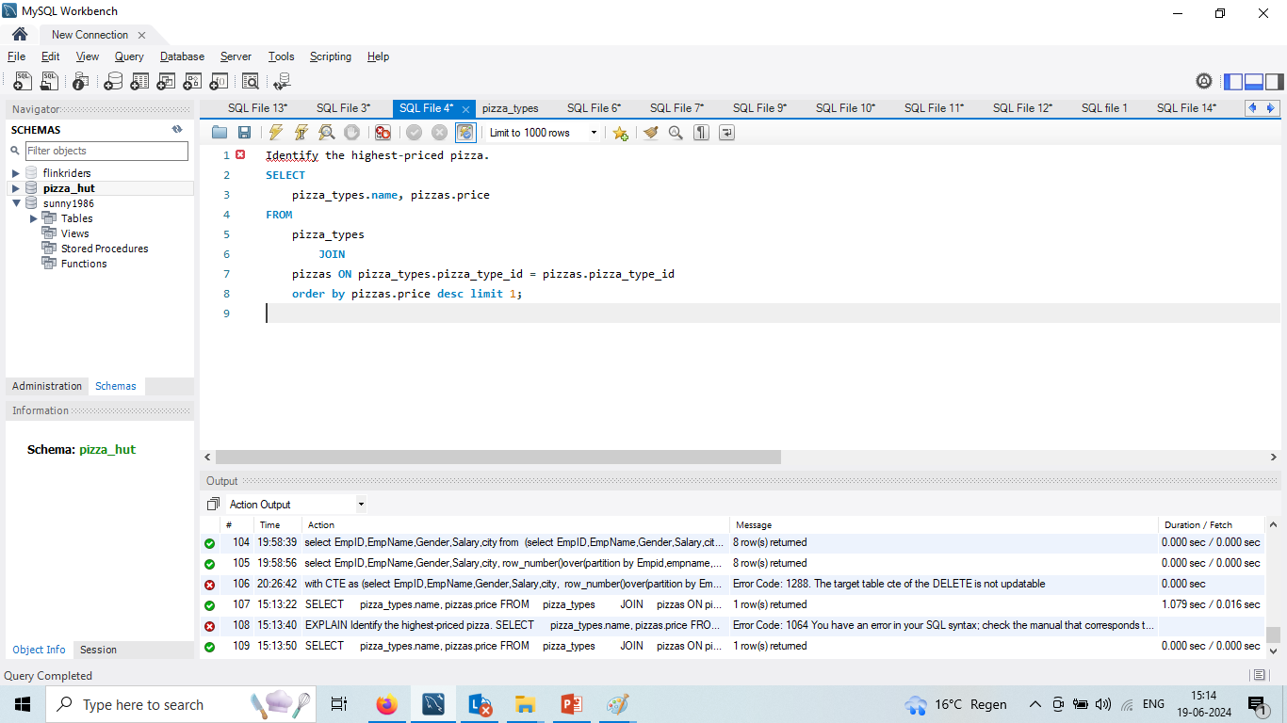
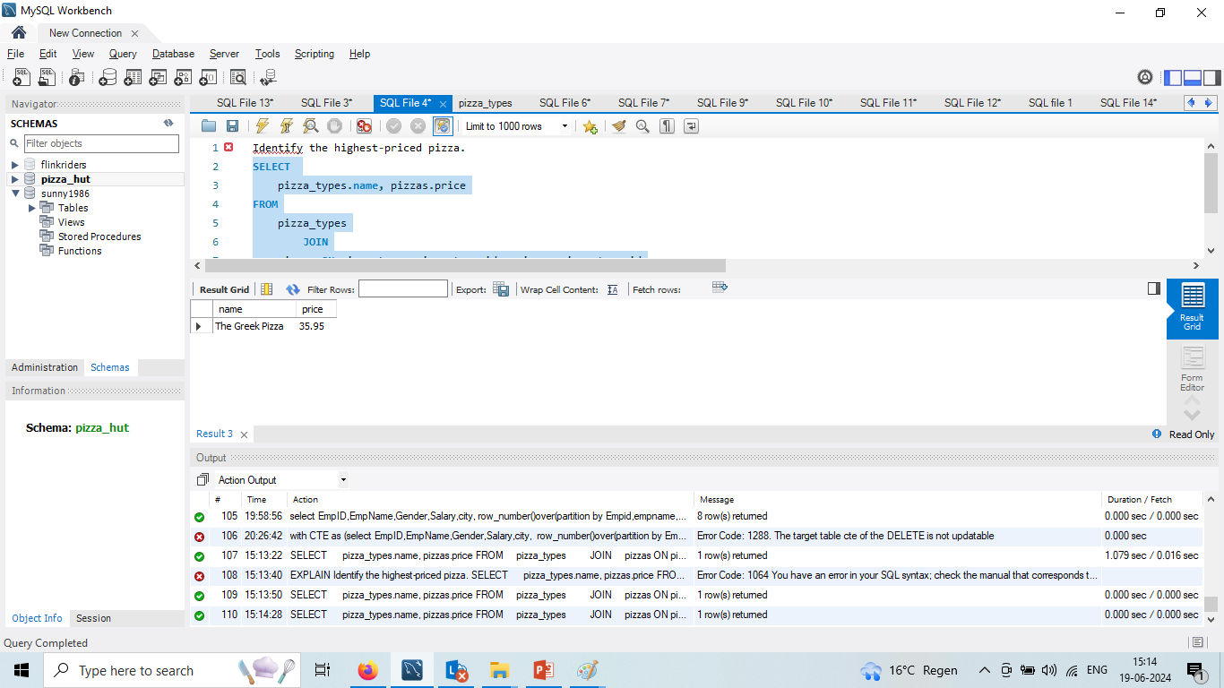
Identify the highest-priced pizza.

Slide 12
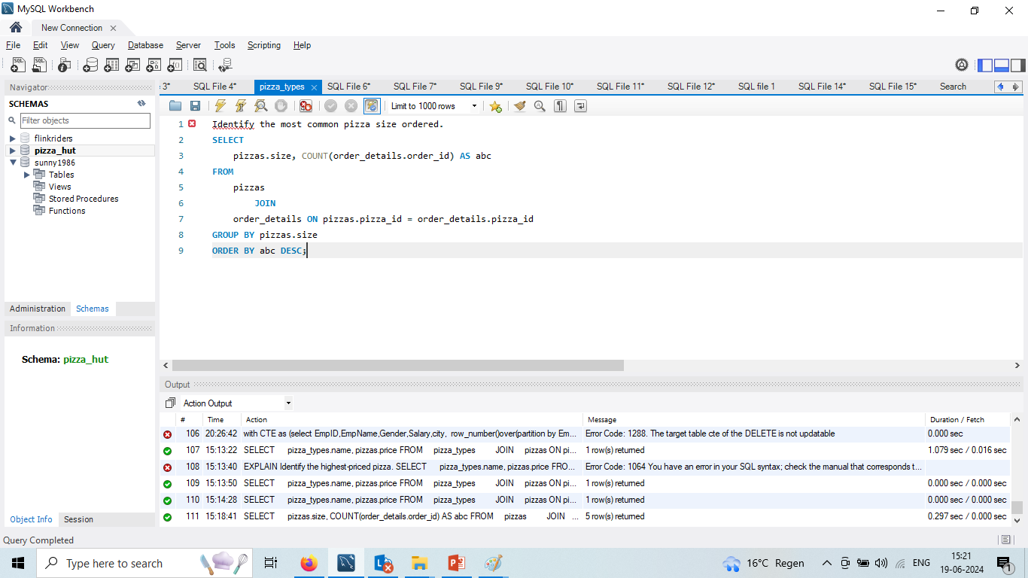
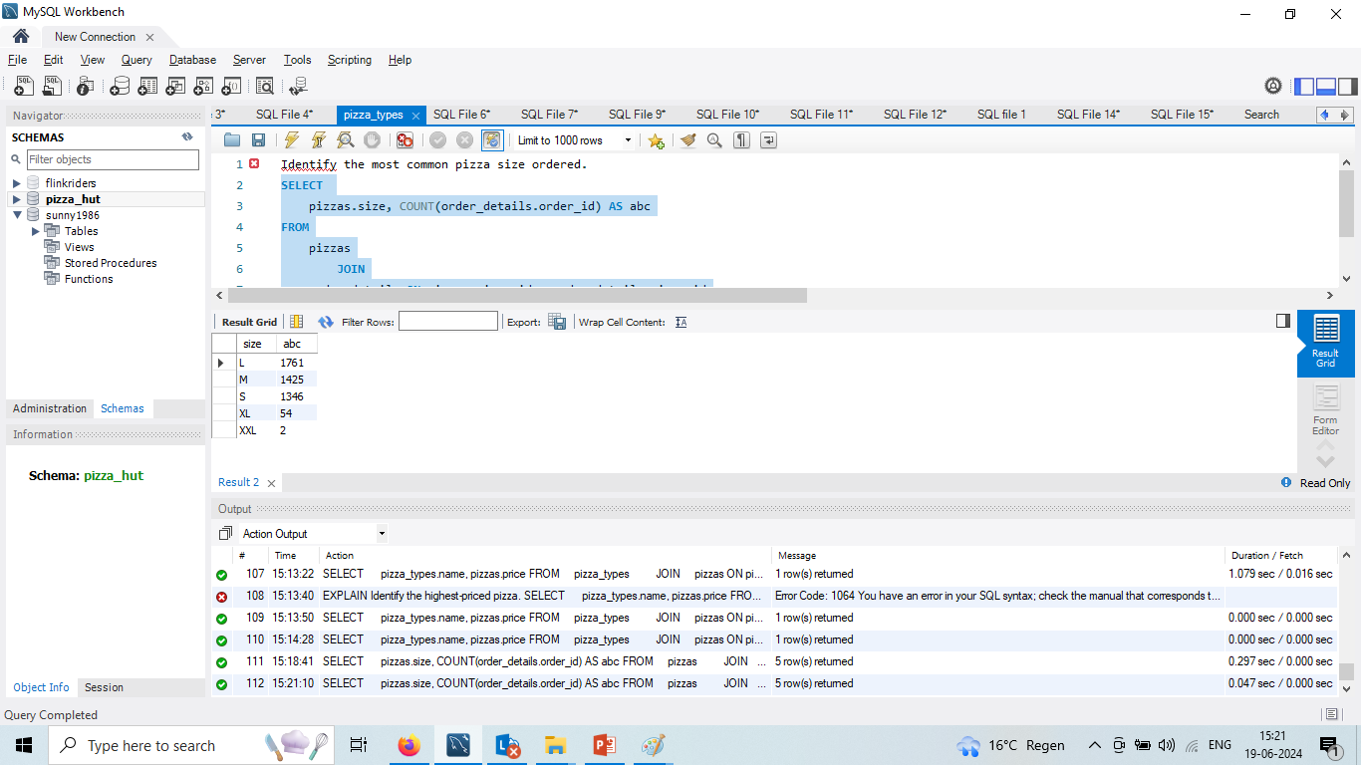
Identify the most common pizza size ordered

Slide 13
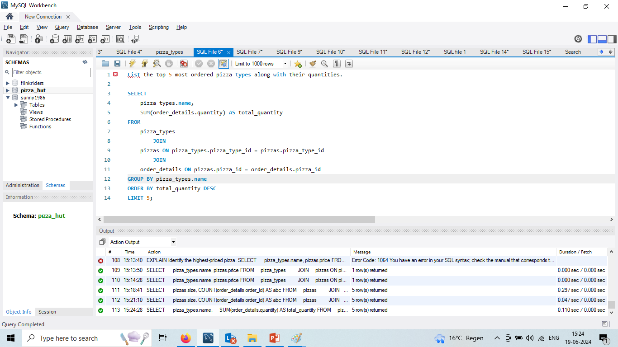
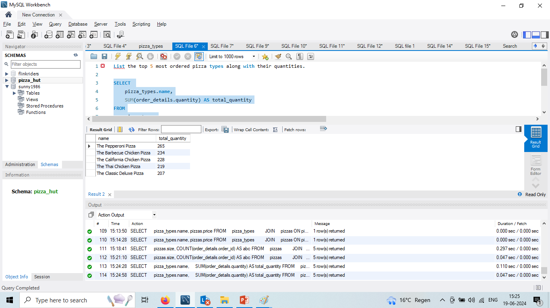
List the top 5 most ordered pizza types along with their quantities

Slide 14
Questions
Intermediate level:
Join the necessary tables to find the total quantity of each pizza category ordered.
Determine the distribution of orders by hour of the day.
Join relevant tables to find the category-wise distribution of pizzas.
Group the orders by date and calculate the average number of pizzas ordered per day.
Determine the top 3 most ordered pizza types based on revenue.

Slide 15
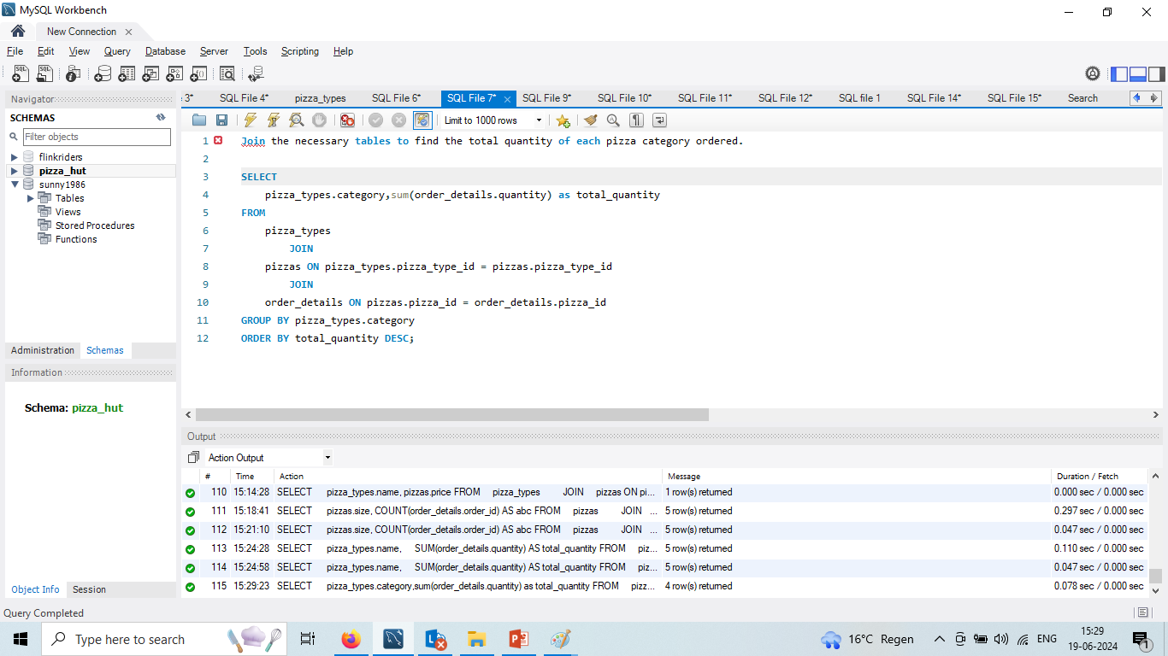
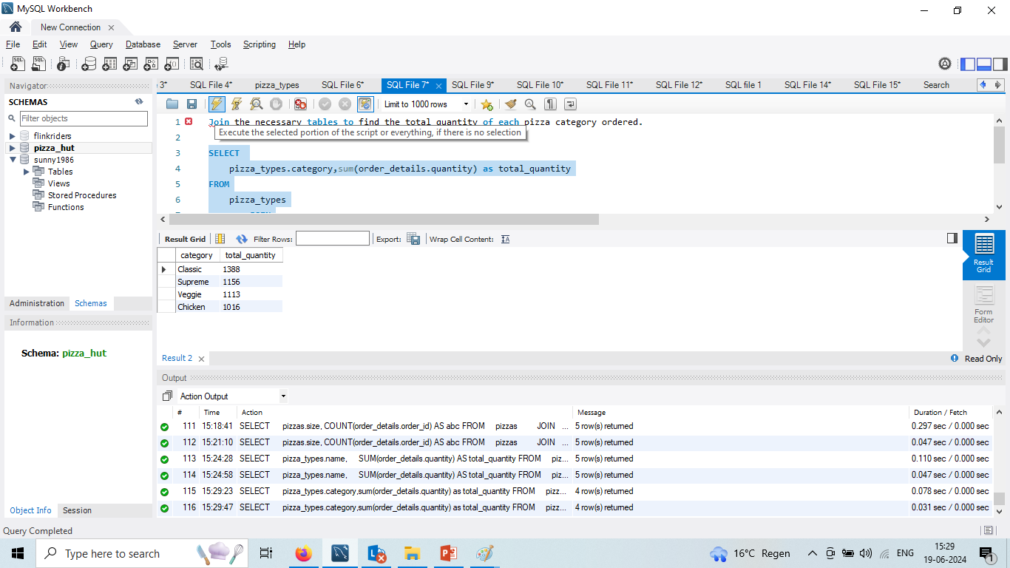
Join the necessary tables to find the total quantity of each pizza category ordered.

Slide 16
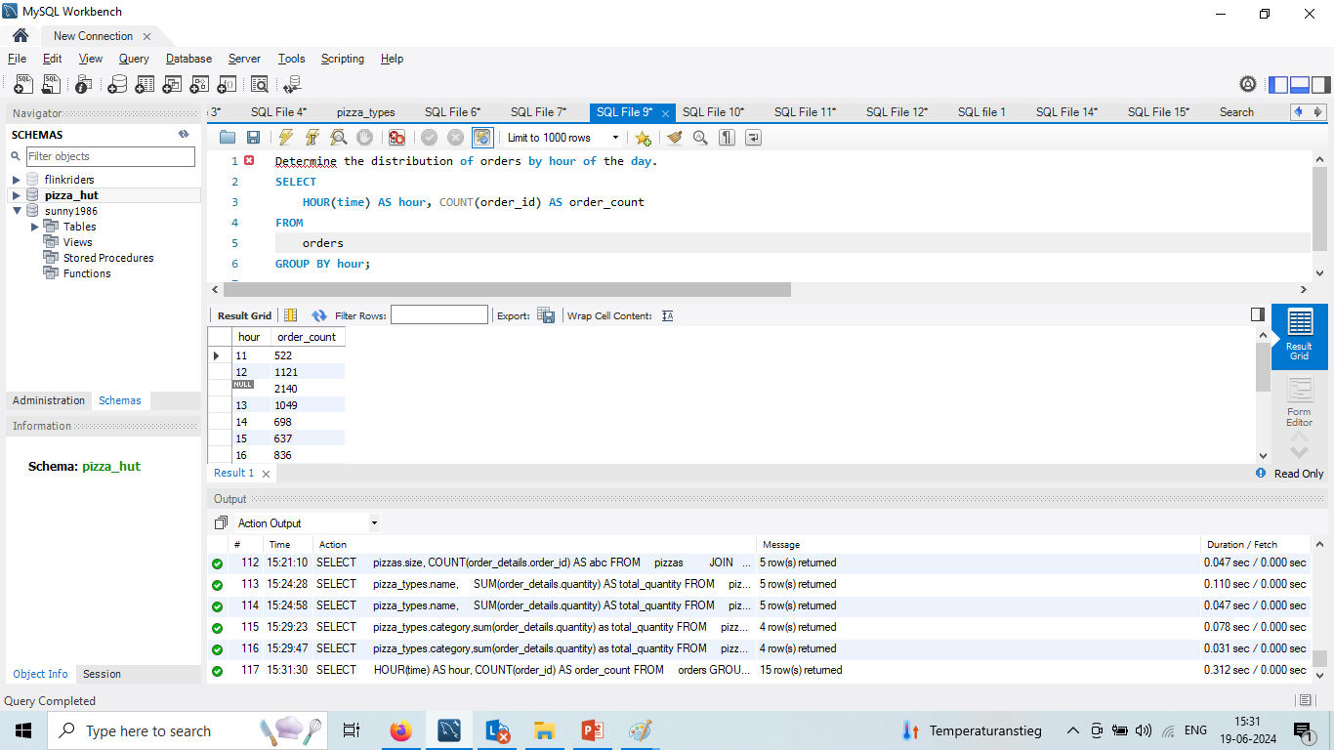
Determine the distribution of orders by hour of the day.

Slide 17

Join relevant tables to find the category-wise distribution of pizzas.

Slide 18
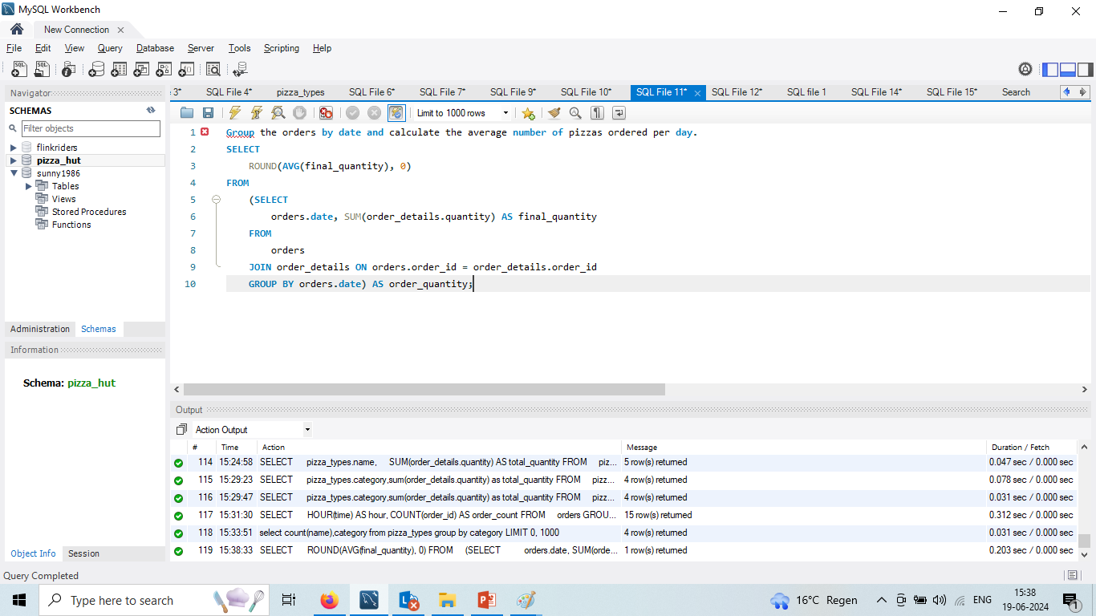
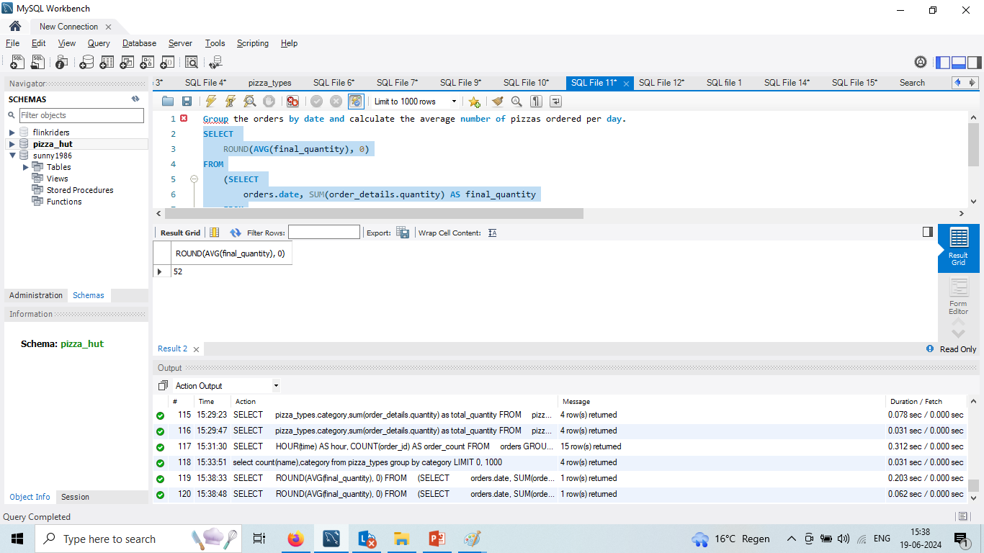
Group the orders by date and calculate the average number of pizzas ordered per day.

Slide 19
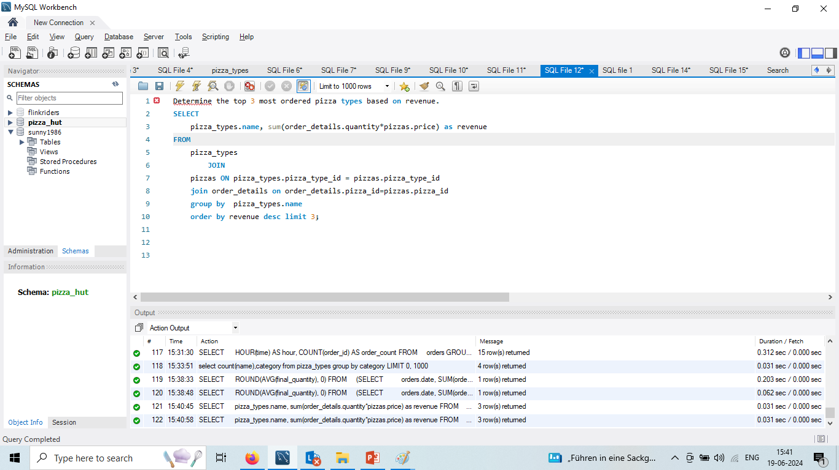
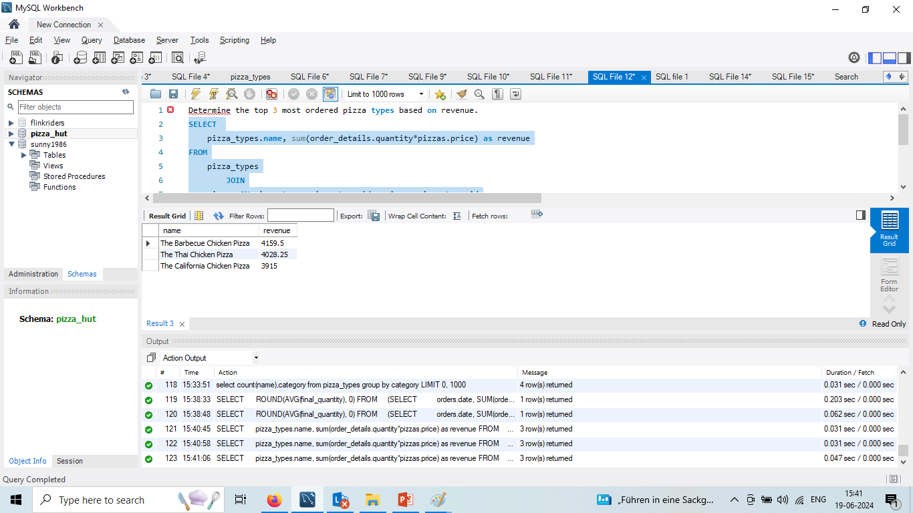
Determine the top 3 most ordered pizza types based on revenue.

Slide 20
Questions
Advanced level:
Calculate the percentage contribution of each pizza type to total revenue.
Analyze the cumulative revenue generated over time.
Determine the top 3 most ordered pizza types based on revenue for each pizza category.

Slide 21
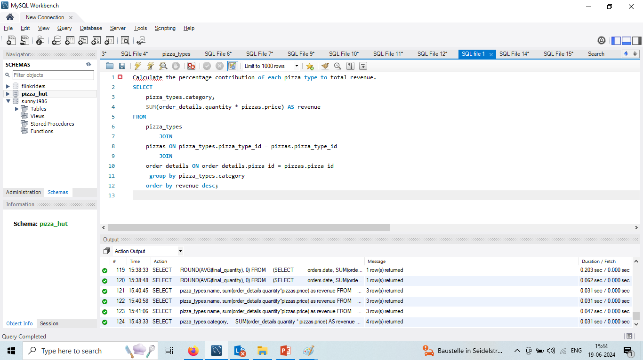
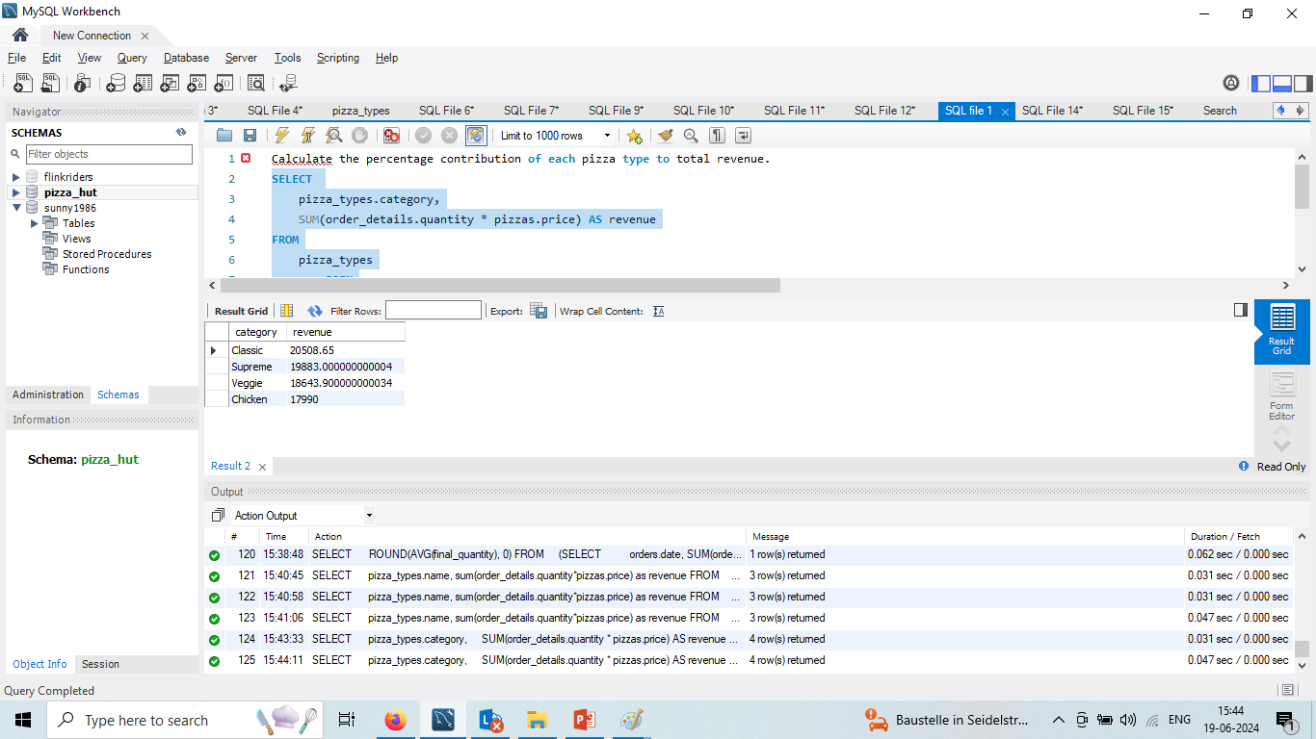
Calculate the percentage contribution of each pizza type to total revenue.

Slide 22
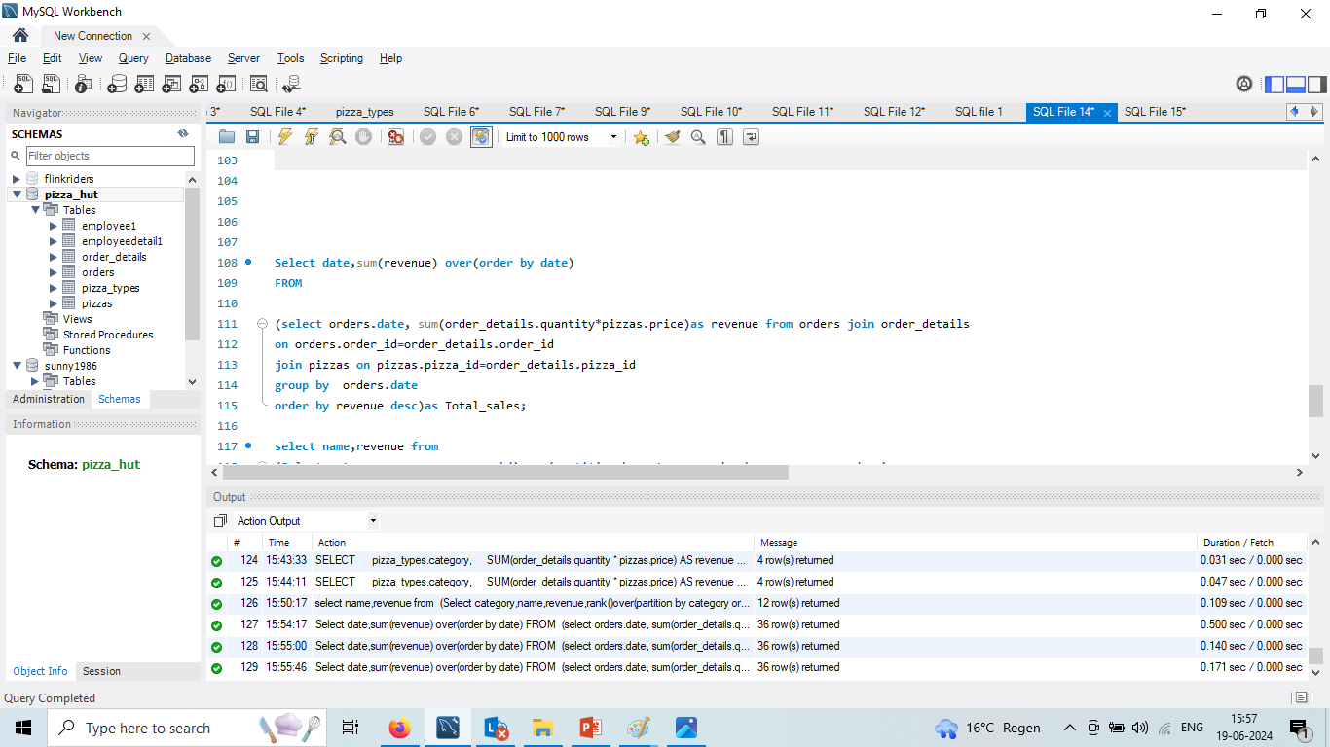
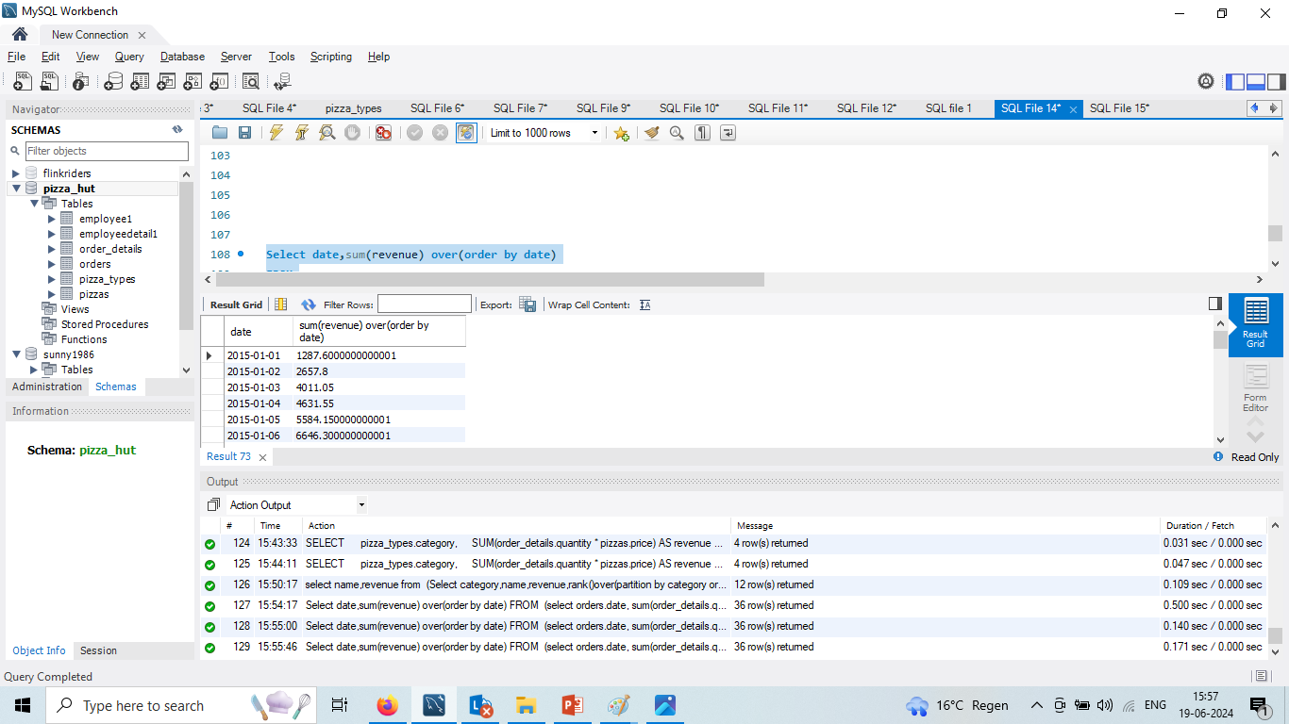
Analyze the cumulative revenue generated over time.

Slide 23
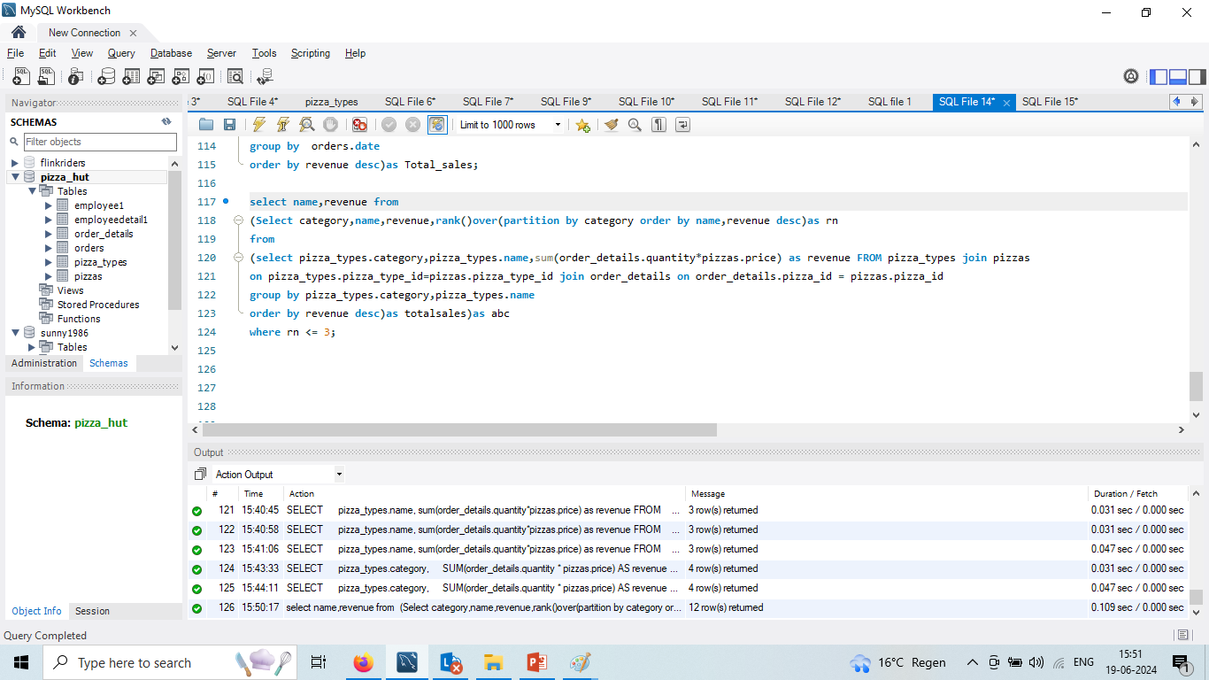
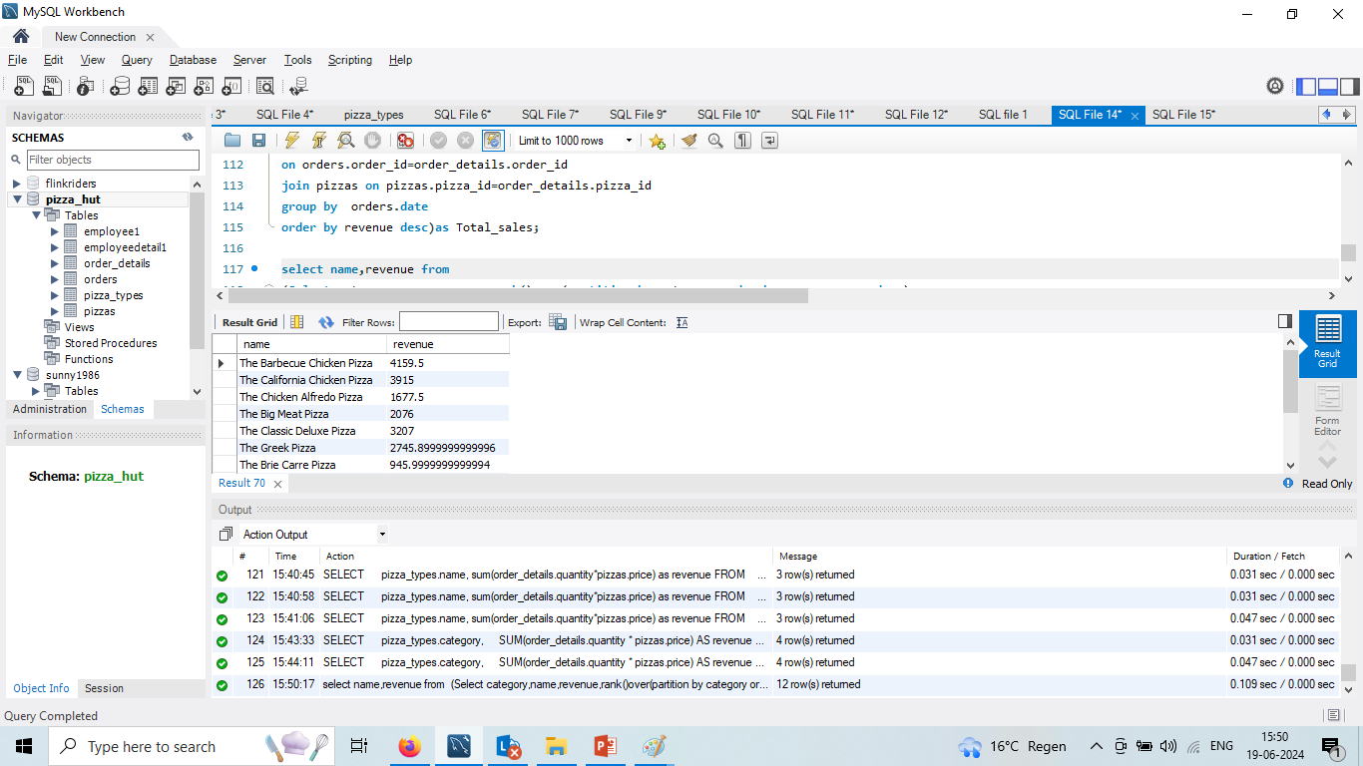
Determine the top most ordered pizza types based on revenue for each pizza category.

Slide 24


